Slide 1
Cryptography
Corporate Computer Security, 4th Edition
Randall J. Boyle & Raymond R. Panko
Chapter 3

Slide 2
Learning Objectives
Explain the concept of cryptography.
Describe symmetric key encryption and the importance of key length.
Explain negotiation stage.
Explain initial authentication, including MS-CHAP.
Describe keying, including public key encryption.
Explain how electronic signatures, including digital signatures, digital certificates, and key-hashed message authentication codes (HMACs) work.
Describe public key encryption for authentication.
Describe quantum security.
Explain cryptographic systems including VPNs, SSL, and IPsec.

Slide 3
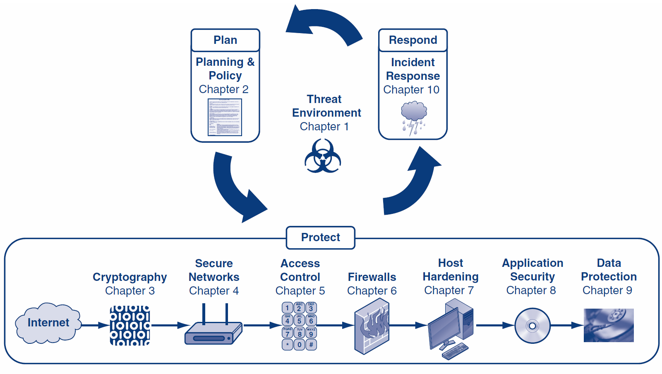

Slide 4
Orientation
Chapter 1 introduced the threat environment
Chapter 2 introduced the plan-protect-respond cycle and covered the planning phase
Chapters 3 through 9 will cover the protection phase
Chapter 3 introduces cryptography, which is important and is used in many other protections

Slide 5
What’s Next?
3.1 What is Cryptography
3.2 Symmetric Key Encryption Ciphers
3.3 Cryptographic System Standards
3.4 The Negotiation Stage
3.5 Initial Authentication Stage
3.6 The Keying Stage
3.7 Message-by-Message Authentication
3.8 Quantum Security
3.9 Cryptographic Systems
3.10 SSL/TLS and IPsec

Slide 6




3.1: Cryptography
Cryptography is the use of mathematical operations to protect messages traveling between parties or stored on a computer
Confidentiality means that someone intercepting your communications cannot read them
???

Slide 7
3.1: Cryptography
Confidentiality is only one cryptographic protection
Authentication means proving one’s identity to another so they can trust you more
Integrity means that the message cannot be changed or, if it is change, that this change will be detected
Known as the CIA of cryptography
No, not that CIA

Slide 8
3.1: Cryptography
Encryption for confidentiality needs a cipher (mathematical method) to encrypt and decrypt
The cipher cannot be kept secret
The two parties using the cipher also need to know a secret key or keys
A key is merely a long stream of bits (1s and 0s)
The key or keys must be kept secret
Cryptanalysts attempt to crack (find) the key

Slide 9
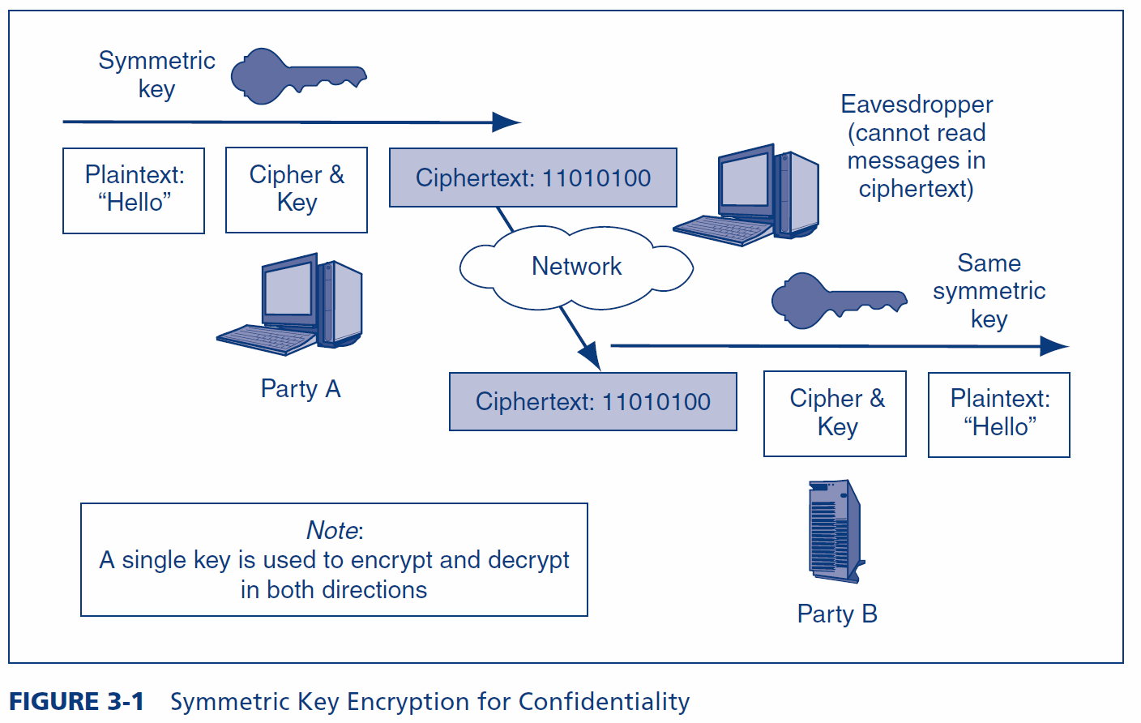
3.1: Symmetric Key Encryption for Confidentiality

Slide 10
3.1: Example Symmetric Key Cipher (Fig. 3-2)
Plaintext | Key | Ciphertext
n | 4 | r
o | 8 | w
w | 15 | l
i | 16 | …
s | 23 | …
t | 16 | …
h | 3 | …
e | 9 | …
t | 12 | …
i | 20 | …
m | 6 | …
e | 25 | …
+4
n o p q r
This is a very weak cipher.
Real ciphers use complex math.

Slide 11
3.1: Types of Ciphers
Substitution Ciphers
Substitute one letter (or bit) for another in each place
The cipher we saw in Figure 3-2 is a substitution cipher
Transposition Ciphers
Transposition ciphers do not change individual letters or bits, but they change their order
Most real ciphers use both substitution and transposition

Slide 12
3.1: Transposition Cipher
 | Key (Part 1)
Key (Part 2) | 1 | 3 | 2
2 | n | o | w
3 | i | s | t
1 | h | e | t
Key = 132 231

Slide 13
3.1: Ciphers versus Codes
Ciphers can encrypt any message expressed in binary (1s and 0s)
This flexibility and the speed of computing makes ciphers dominant for encryption today
Codes are more specialized
They substitute one thing for another
Usually a word for another word or a number for a word
Codes are good for humans and may be included in messages sent via encipherment

Slide 14
3.1: Japanese Naval Operational Code JN-25 (Simplified)
Message | Code
From | 17434
Akagi | 63717
To | 83971
Truk | 11131
STOP | 34058
ETA | 53764
6 PM | 73104
STOP | 26733
Require | 29798
B | 72135
N | 54678
STOP | 61552
Transmitted:
174346371783971…

Slide 15
3.1: Key Length and Exhaustive Search Time
Key Length in Bits | Number of Possible Keys
1 | 2
2 | 4
4 | 16
8 | 256
16 | 65,536
40 | 1,099,511,627,776
56 | 72,057,594,037,927,900
112 | 5,192,296,858,534,830,000,000,000,000,000,000
112 | 5.1923E+33
168 | 3.74144E+50
256 | 1.15792E+77
512 | 1.3408E+154
Each extra bit
doubles the number of keys
Shaded keys are
Strong symmetric keys (>=100 bits)

Slide 16
3.1: Key Length and Exhaustive Search Time
Public key/private key pairs (discussed later in the chapter) must be much longer than symmetric keys to be considered to be strong because of the disastrous consequences that could occur if a private key is cracked and because private keys cannot be changed frequently.
Public keys and private keys must be at least 512 to 1,024 bits long.

Slide 17
What’s Next?
3.1 What is Cryptography
3.2 Symmetric Key Encryption Ciphers
3.3 Cryptographic System Standards
3.4 The Negotiation Stage
3.5 Initial Authentication Stage
3.6 The Keying Stage
3.7 Message-by-Message Authentication
3.8 Quantum Security
3.9 Cryptographic Systems
3.10 SSL/TLS and IPsec

Slide 18
3.2: Major Symmetric Key Encryption Ciphers
 | RC4 | DES | 3DES | AES
Key Length (bits) | 40 bits or more | 56 | 112 or 168 | 128, 192, or 256
Key Strength | Very weak at 40 bits | Weak | Strong | Strong
Processing Requirements | Low | Moderate | High | Low
RAM Requirements | Low | Moderate | Moderate | Low
Remarks | Can use keys of variable length | Created in the 1970s | Applies DES three times with two or three different DES keys | Today’s gold standard for symmetric key encryption

Slide 19
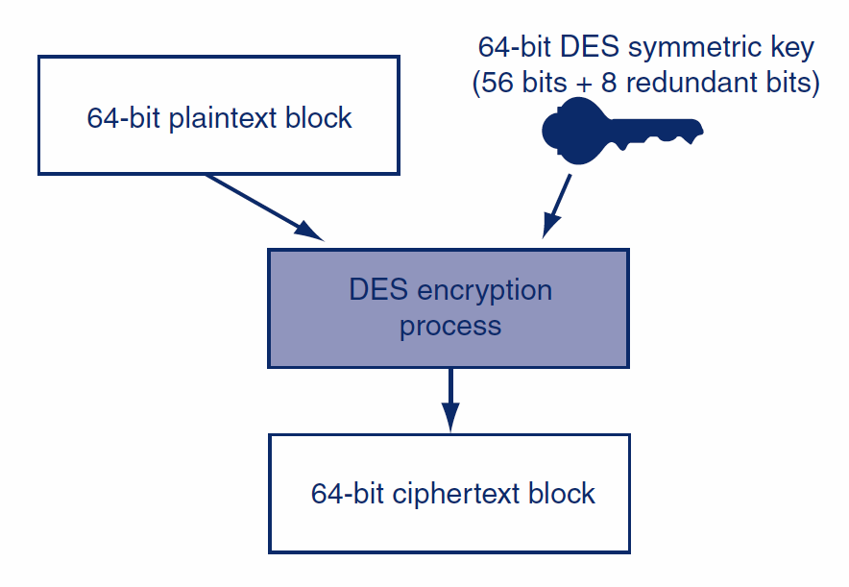
3.2: DES Block Encryption
The DES cipher encrypts messages 64 bits at a time.
The DES cipher (in codebook mode) needs two inputs.

Slide 20
What’s Next?
3.1 What is Cryptography
3.2 Symmetric Key Encryption Ciphers
3.3 Cryptographic System Standards
3.4 The Negotiation Stage
3.5 Initial Authentication Stage
3.6 The Keying Stage
3.7 Message-by-Message Authentication
3.8 Quantum Security
3.9 Cryptographic Systems
3.10 SSL/TLS and IPsec

Slide 21
3.3: Cryptographic System Stages
Cryptographic Systems
Encryption for confidentiality is only one cryptographic protection
Individual users and corporations cannot be expected to master these many aspects of cryptography
Consequently, crypto protections are organized into complete cryptographic systems that provide a broad set of cryptographic protection

Slide 22
3.3: Cryptographic System Stages
Cryptographic Systems
Two parties first agree upon a particular cryptographic system to use
Each cryptographic system dialogue begins with three brief handshaking stages
The two parties then engage in cryptographically protected communication
This ongoing communication stage usually constitutes nearly all of the dialogue

Slide 23
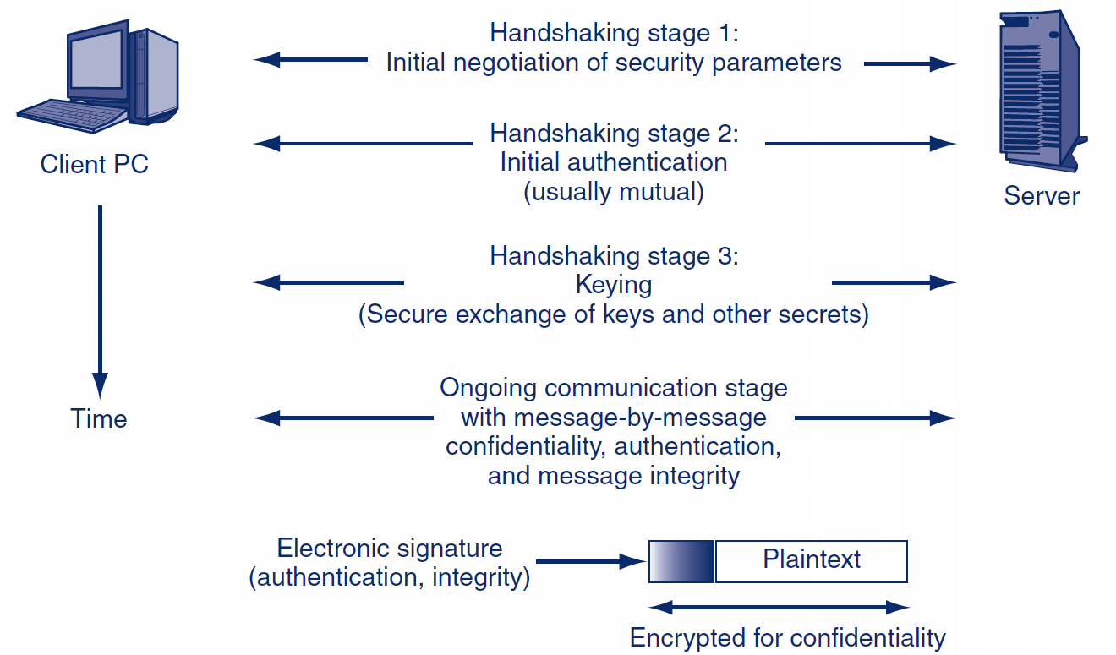
3.3: Cryptographic System Stages

Slide 24
What’s Next?
3.1 What is Cryptography
3.2 Symmetric Key Encryption Ciphers
3.3 Cryptographic System Standards
3.4 The Negotiation Stage
3.5 Initial Authentication Stage
3.6 The Keying Stage
3.7 Message-by-Message Authentication
3.8 Quantum Security
3.9 Cryptographic Systems
3.10 SSL/TLS and IPsec

Slide 25
Stage 1: Selecting Security Methods and Parameters
Selecting methods and parameters
Authentication
Keying (the secure exchange of secrets)
Ongoing communication

Slide 26
3.4: Selected SSL/TLS Cipher Suites
Cipher Suite | Key Negotiation | Digital Signature Method | Symmetric Key Encryption Method | Hashing Method for HMAC | Strength
NULL_WITH_NULL_NULL | None | None | None | None | None
RSA_EXPORT_WITH_ RC4_40_MD5 | RSA export strength (40 bits) | RSA export strength (40 bits) | RC4 (40-bit key) | MD5 | Weak
RSA_WITH_DES_CBC_ SHA | RSA | RSA | DES_CBC | SHA-1 | Stronger but not very strong
DH_DSS_WITH_3DES_ EDE_CBC_SHA | Diffie-Hellman | Digital Signature Standard | 3DES_ EDE_CBC | SHA-1 | Strong
RSA_WITH_AES_256_CBC_SHA256 | RSA | RSA | AES 256 bits | SHA-256 | Very strong

Slide 27
What’s Next?
3.1 What is Cryptography
3.2 Symmetric Key Encryption Ciphers
3.3 Cryptographic System Standards
3.4 The Negotiation Stage
3.5 Initial Authentication Stage
3.6 The Keying Stage
3.7 Message-by-Message Authentication
3.8 Quantum Security
3.9 Cryptographic Systems
3.10 SSL/TLS and IPsec

Slide 28
Stage 2: Authentication
Selecting methods and parameters
Authentication
Keying (the secure exchange of secrets)
Ongoing communication

Slide 29
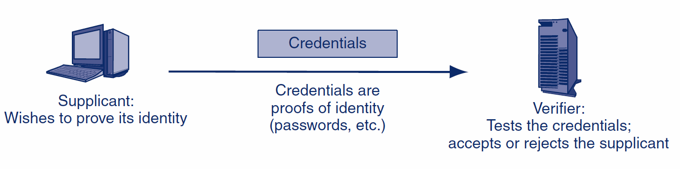
3.5: Authentication: Supplicant, Verifier, and Credentials

Slide 30
3.5: Hashing
Hashing
A hashing algorithm is applied to a bit string of any length
The result of the calculation is called the hash
For a given hashing algorithm, all hashes are the same short length
Hashing
Algorithm
Bit string of any length
Hash: bit string of small fixed length

Slide 31
3.5: Hashing
Hashing versus Encryption
Characteristic | Encryption | Hashing
Result length | About the same length as the plaintext | Short fixed length regardless of message length
Reversible? | Yes. Decryption | No. There is no way to get from the short hash back to the long original message

Slide 32
3.5: Hashing
Hashing Algorithms
MD5 (128-bit hashes)
SHA-1 (160-bit hashes)
SHA-224, SHA-256, SHA-384, and SHA-512 (name gives hash length in bits)
Note: MD5 and SHA-1 should not be used because they have been shown to be unsecure

Slide 33
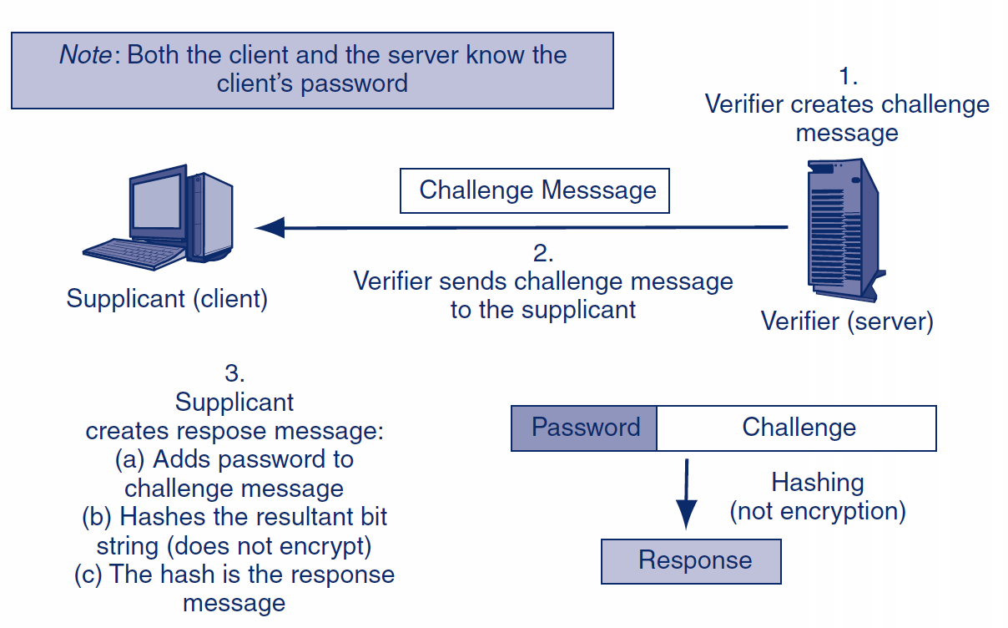
3.5: MS-CHAP Challenge-Response Authentication Protocol

Slide 34
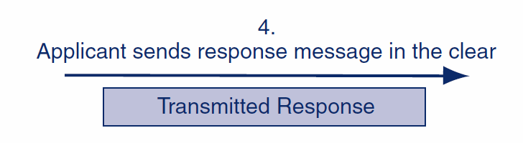
3.5: MS-CHAP Challenge-Response Authentication Protocol

Slide 35
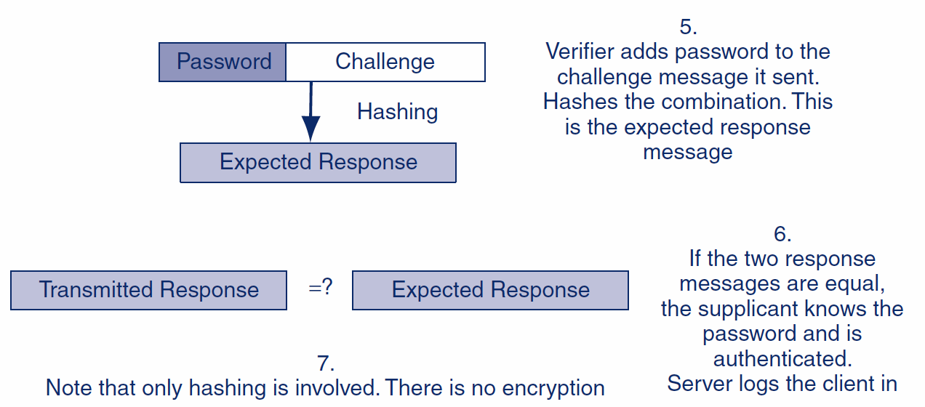
3.5: MS-CHAP Challenge-Response Authentication Protocol

Slide 36
What’s Next?
3.1 What is Cryptography
3.2 Symmetric Key Encryption Ciphers
3.3 Cryptographic System Standards
3.4 The Negotiation Stage
3.5 Initial Authentication Stage
3.6 The Keying Stage
3.7 Message-by-Message Authentication
3.8 Quantum Security
3.9 Cryptographic Systems
3.10 SSL/TLS and IPsec

Slide 37
Stage 3: Keying
Selecting methods and parameters
Authentication
Keying (the secure exchange of secrets)
Ongoing communication

Slide 38
3.6: Public Key Encryption for Confidentiality
There are two types of ciphers used for confidentiality
In symmetric key encryption for confidentiality, the two sides use the same key
For each dialogue (session), a new symmetric key is generated: the symmetric session key
In public key encryption, each party has a public key and a private key that are never changed
A person’s public key is available to anyone
A person keeps his or her private key secret

Slide 39
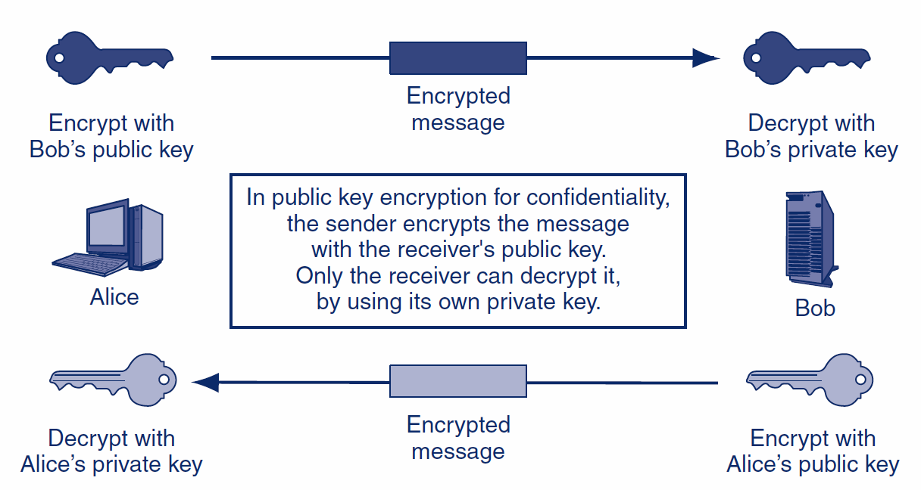
3.6: Public Key Encryption for Confidentiality

Slide 40
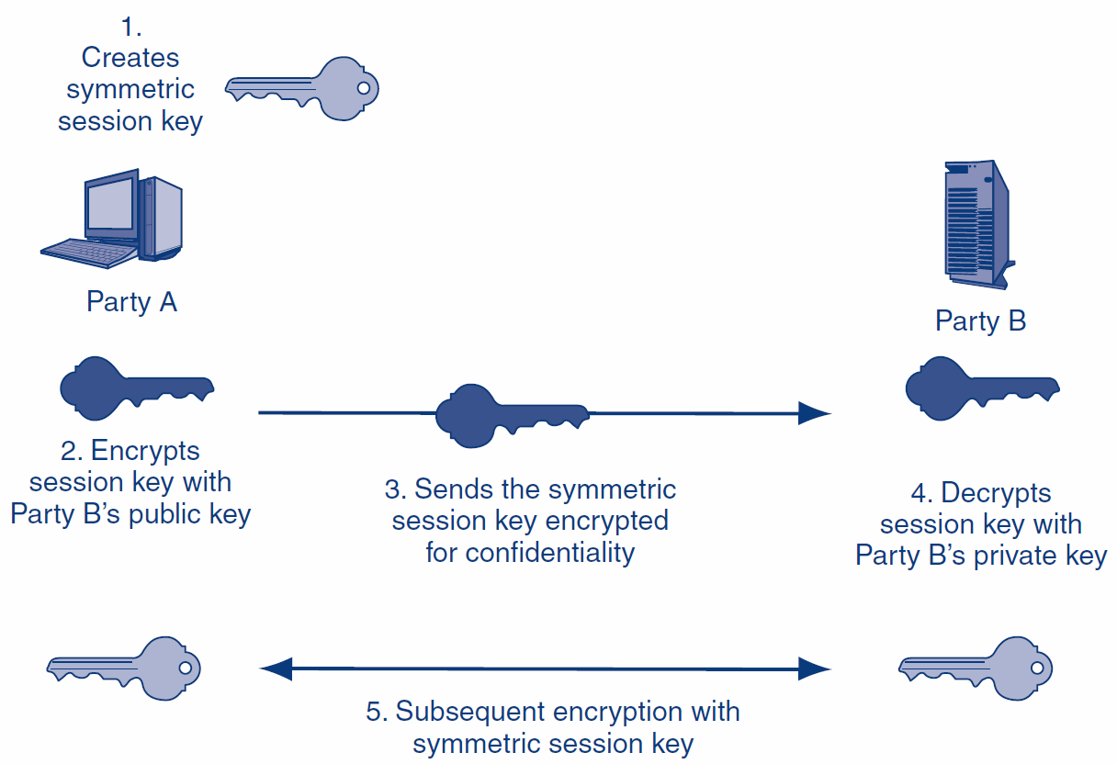
3.6: Public Key Keying for Symmetric Session Keys

Slide 41
3.6: Keying Using Diffie-Hellman Key Agreement
The two parties exchange parameters p and g
Each uses a number that is never shared explicitly to compute a second number
Each sends the other their second number
Each does another computation on the second computed number
Both get the third number, which is the key
All of this communication is sent in the clear

Slide 42
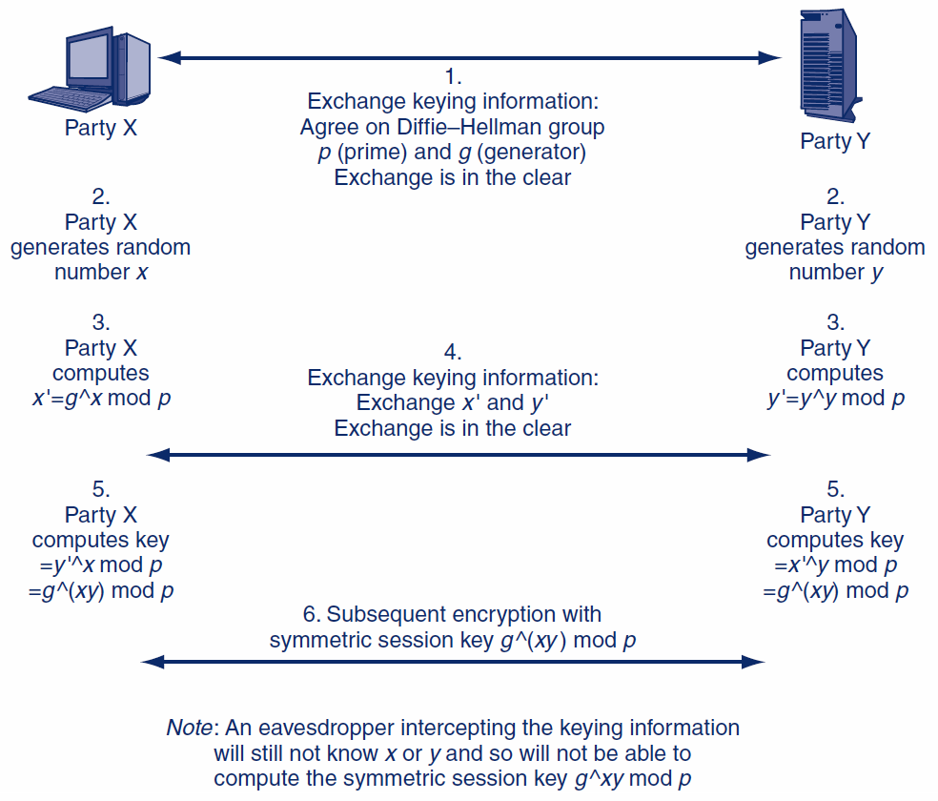
3.6: Keying Using Diffie-Hellman Key Agreement
The gory details

Slide 43
What’s Next?
3.1 What is Cryptography
3.2 Symmetric Key Encryption Ciphers
3.3 Cryptographic System Standards
3.4 The Negotiation Stage
3.5 Initial Authentication Stage
3.6 The Keying Stage
3.7 Message-by-Message Authentication
3.8 Quantum Security
3.9 Cryptographic Systems
3.10 SSL/TLS and IPsec

Slide 44
Stage 4: Ongoing Communication
Selecting methods and parameters
Authentication
Keying (the secure exchange of secrets)
Ongoing communication

Slide 45
3.7: Ongoing Communication
Consumes nearly all of the dialogues
Message-by-Message Encryption
Nearly always uses symmetric key encryption
Already covered
Public key encryption is too inefficient
Message-by-Message Authentication
Digital signatures
Message authentication codes (MACs)
Also provide message-by-message integrity

Slide 46
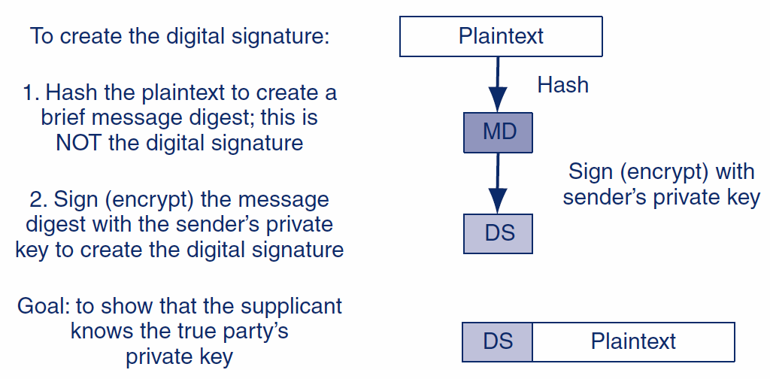
3.7: Digital Signature for Message-by-Message Authentication

Slide 47
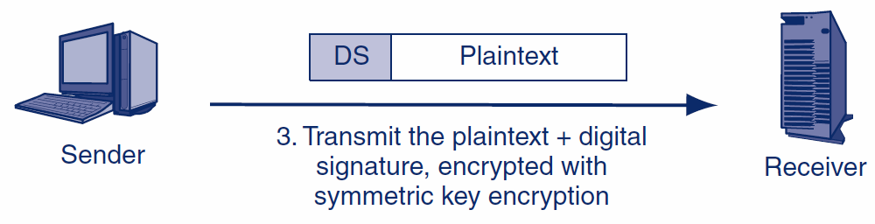
3.7: Digital Signature for Message-by-Message Authentication
Encryption is done to protect the plaintext.
It is not needed for message-by-message authentication.

Slide 48
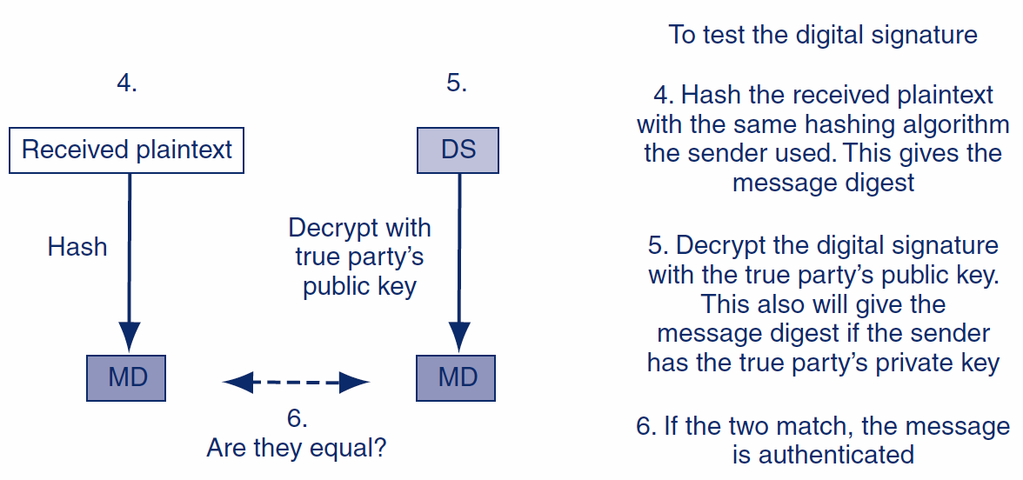
3.7: Digital Signature for Message-by-Message Authentication

Slide 49
3.7: Public Key Encryption for Confidentiality and Authentication
Encryption Goal | Sender Encrypts with | Receiver Decrypts with
Public Key Encryption for Confidentiality | The receiver’s public key | The receiver’s private key
Public Key Encryption for Authentication | The sender’s private key | The True Party’s public key (not the sender’s public key)
Point of frequent confusion

Slide 50
3.7: Finding the True Party’s Public Key
Cannot use the sender’s public key
It would always “validate” the sender’s digital signature
Normally requires a digital certificate
File provided by a certificate authority (CA)
The certificate authority must be trustworthy
Digital certificate provides the subject’s (True Party’s) name and public key
Don’t confuse digital signatures and the digital certificates used to test digital signatures!

Slide 51
3.7: X.509 Digital Certificate Fields
Field | Description
Version Number | Version number of the X.509 standard. Most certificates follow Version 3. Different versions have different fields. This figure reflects the Version 3 standard.
Issuer | Name of the Certificate Authority (CA).
Serial Number | Unique serial number for the certificate, set by the CA.
Subject (True Party) | The name of the person, organization, computer, or program to which the certificate has been issued. This is the true party.
Public Key | The public key of the subject (the true party).
Public Key Algorithm | The algorithm the subject uses to sign messages with digital signatures.
Serial number allows the receiver to check if the digital certificate has been revoked by the CA.
Certificate provides the True Party’s public key.

Slide 52
3.7: X.509 Digital Certificate Fields
Field | Description
Digital Signature | The digital signature of the certificate, signed by the CA with the CA’s own private key. For testing certificate authentication and integrity. User must know the CA’s public key independently.
Signature Algorithm Identifier | The digital signature algorithm the CA uses to sign its certificates.
Other Fields | …
The CA signs the cert with its own private key so that the cert’s validity can be checked for alterations.

Slide 53
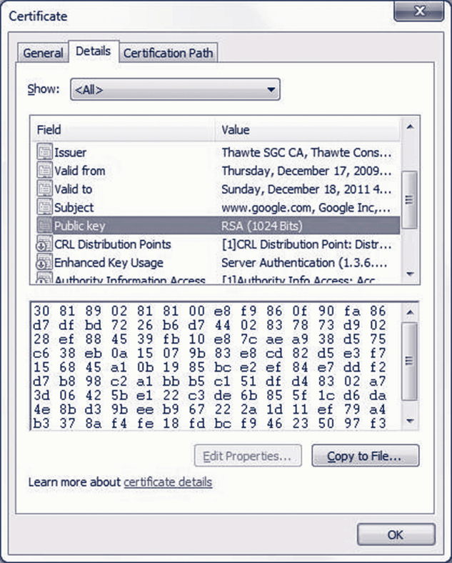
3.7: Digital certificate for Google.com

Slide 54
3.7: Verifying the Digital Certificate
Testing the Digital Signature
The digital certificate has a digital signature of its own
Signed with the Certificate Authority’s (CA’s) private key
Must be tested with the CA’s well-known public key
If the test works, the certificate is authentic and unmodified

Slide 55
3.7: Verifying the Digital Certificate
Checking the Valid Period
Certificate is valid only during the valid period in the digital certificate (not shown in the figure)
If the current time is not within the valid period, reject the digital certificate

Slide 56
3.7: Verifying the Digital Certificate
Checking for Revocation
Certificates may be revoked for improper behavior or other reasons
Revocation must be tested
Cannot be done by looking at fields within the certificate
Receiver must check with the CA

Slide 57
3.7: Verifying the Digital Certificate
Checking for Revocation
Verifier may download the entire certificate revocation list from the CA
See if the serial number is on the certificate revocation list
If so, do not accept the certificate
Or the verifier may send a query to the CA
Requires the CA to support the Online Certificate Status Protocol

Slide 58
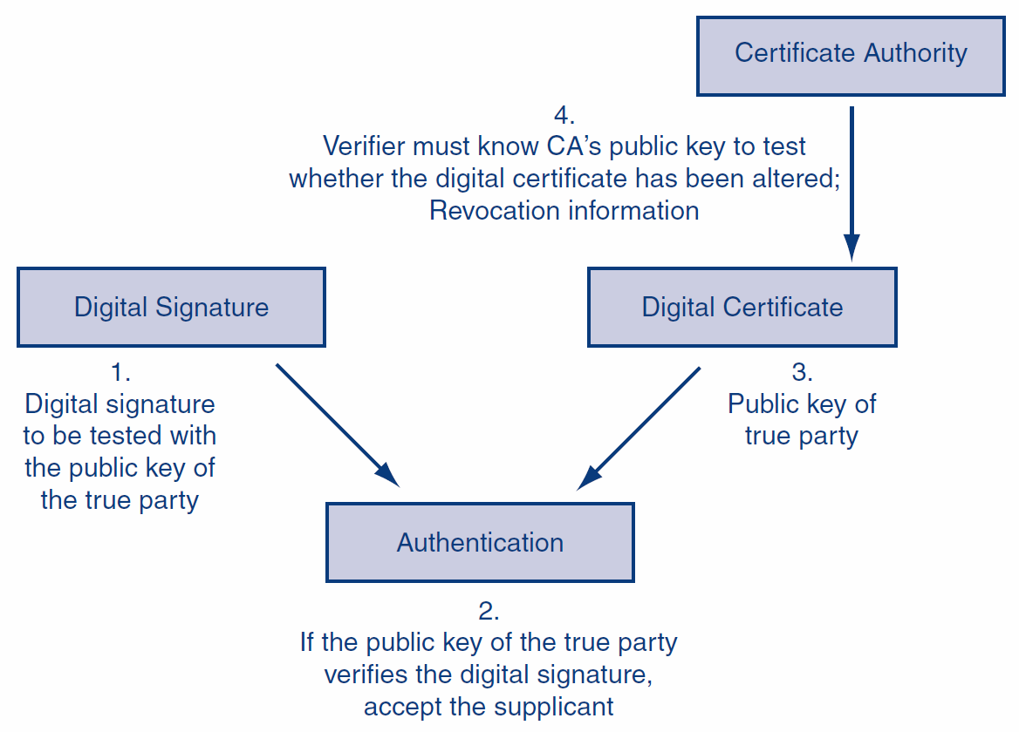
3.7: Digital Signature and Digital Certificate in Authentication (overview)

Slide 59
3.7: Message-by-Message Authentication
Also Brings Message Integrity
If the message has been altered, the authentication method will fail automatically
Digital Signature Authentication
Uses public key encryption for authentication
Very strong but expensive
Key-Hashed Message Authentication Codes
An alternate authentication method using hashing
Much less expensive than digital signature authentication
Much more widely used

Slide 60
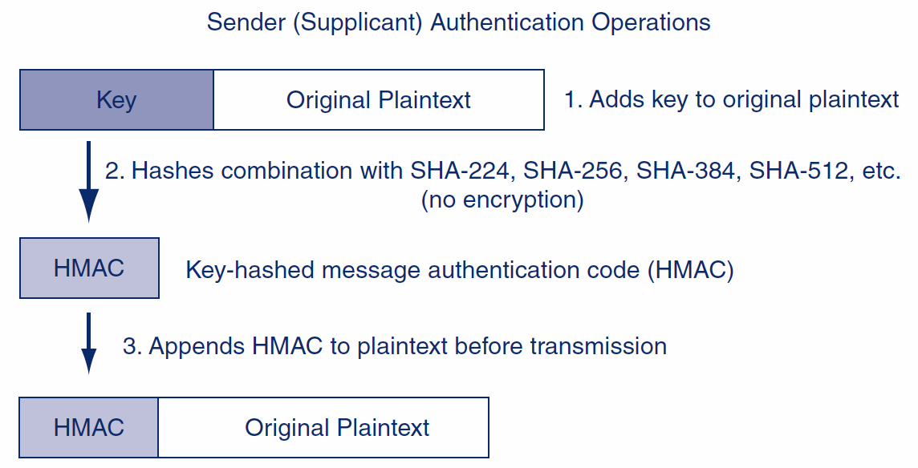
3.7: Key-Hashed Message Authentication Code (HMAC)

Slide 61
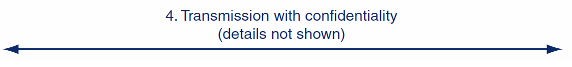
3.7: Key-Hashed Message Authentication Code (HMAC)
As in the case of digital signatures, confidentiality is done to protect the plaintext.
It is not needed for authentication and has nothing to do with authentication.

Slide 62
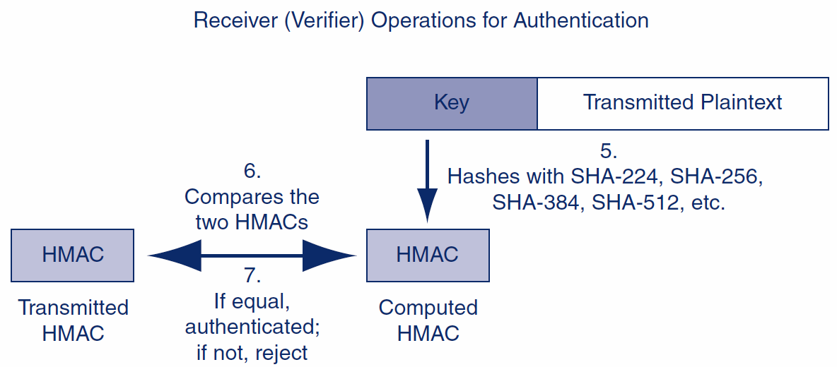
3.7: Key-Hashed Message Authentication Code (HMAC)

Slide 63
3.7: Nonrepudiation
Nonrepudiation means that the sender cannot deny that he or she sent a message
With digital signatures, the sender must use his or her private key
It is difficult to repudiate that you sent something if you use your private key
With HMACs, both parties know the key used to create the HMAC
The sender can repudiate the message, claiming that the receiver created it

Slide 64
3.7: Nonrepudiation
Packet-level nonrepudiation is unimportant in most cases
The application message—an e-mail message, a contract, etc.—is the important thing
If the application layer message has its own digital signature, you have nonrepudiation for the application message, even if you use HMACs at the internet layer for packet authentication

Slide 65
3.7: Replay Attacks and Defenses
Replay Attacks
Capture and then retransmit an encrypted message later
May have a desired effect
Even if the attacker cannot read the message

Slide 66
3.7: Replay Attacks and Defenses
Thwarting Replay Attacks
Time stamps to ensure freshness of each message
Sequence numbers so that repeated messages can be detected
Nonces
Unique randomly generated number placed in each request message
Reflected in the response message
If a request arrives with a previously used nonce, it is rejected

Slide 67
3.7: Core Cryptographic Processes
 | Confidentiality | Authentication
Symmetric Key Encryption | Applicable. Sender encrypts with key shared with the receiver. | Not applicable.
Public Key Encryption | Applicable. Sender encrypts with receiver’s public key. Receiver decrypts with the receiver’s own private key. | Applicable. Sender (supplicant) encrypts with own private key. Receiver (verifier) decrypts with the public key of the true party, usually obtained from the true party’s digital certificate.
Hashing | Not applicable. | Applicable. Used in MS-CHAP for initial authentication and in HMACs for message-by-message authentication.

Slide 68
What’s Next?
3.1 What is Cryptography
3.2 Symmetric Key Encryption Ciphers
3.3 Cryptographic System Standards
3.4 The Negotiation Stage
3.5 Initial Authentication Stage
3.6 The Keying Stage
3.7 Message-by-Message Authentication
3.8 Quantum Security
3.9 Cryptographic Systems
3.10 SSL/TLS and IPsec

Slide 69
3.8: Quantum Security
Quantum Mechanics
Describes the behavior of fundamental particles
Complex and even weird results

Slide 70
3.8: Quantum Security
Quantum Key Distribution
Transmits a very long key—as long as the message
This is a one-time key that will not be used again
A one-time key as long as a message cannot be cracked by cryptanalysis
If an interceptor reads part of the key in transit, this will be immediately apparent to the sender and receiver

Slide 71
3.8: Quantum Security
Quantum Key Cracking
Tests many keys simultaneously
If quantum key cracking becomes capable of working on long keys, today’s strong key lengths will offer no protection

Slide 72
What’s Next?
3.1 What is Cryptography
3.2 Symmetric Key Encryption Ciphers
3.3 Cryptographic System Standards
3.4 The Negotiation Stage
3.5 Initial Authentication Stage
3.6 The Keying Stage
3.7 Message-by-Message Authentication
3.8 Quantum Security
3.9 Cryptographic Systems
3.10 SSL/TLS and IPsec

Slide 73
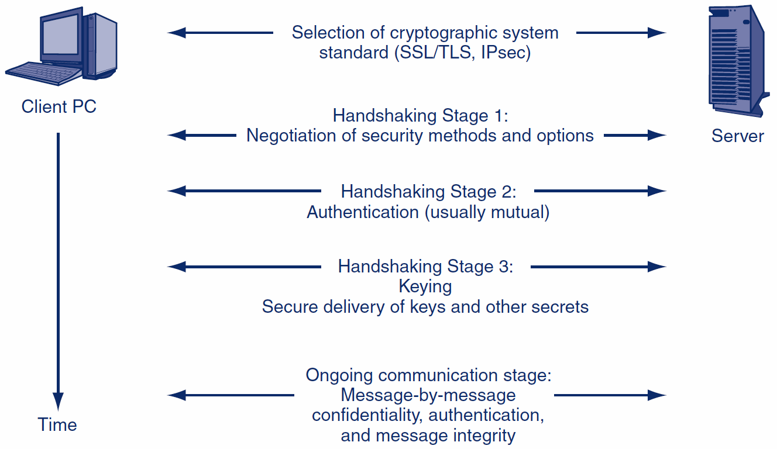
3.9: Cryptographic Systems

Slide 74
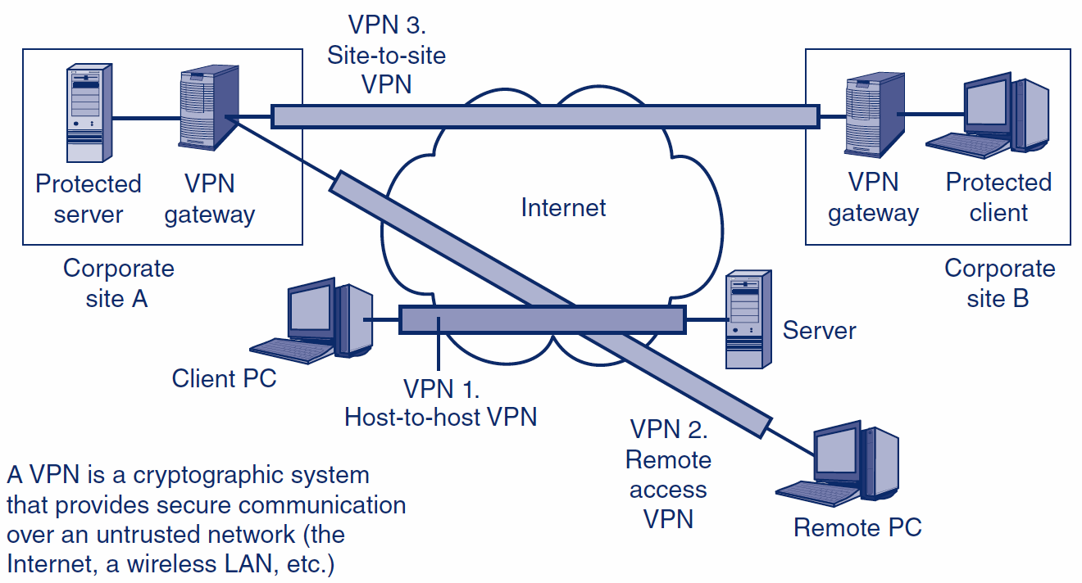
3.9: Virtual Private Networks (VPNs)

Slide 75
What’s Next?
3.1 What is Cryptography
3.2 Symmetric Key Encryption Ciphers
3.3 Cryptographic System Standards
3.4 The Negotiation Stage
3.5 Initial Authentication Stage
3.6 The Keying Stage
3.7 Message-by-Message Authentication
3.8 Quantum Security
3.9 Cryptographic Systems
3.10 SSL/TLS and IPsec

Slide 76
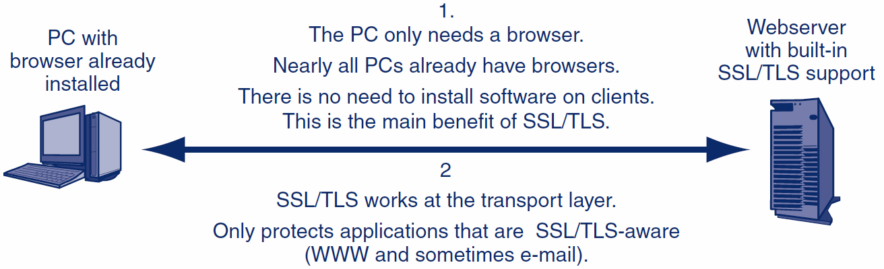
3.10: Host-to-Host SSL/TLS VPN

Slide 77
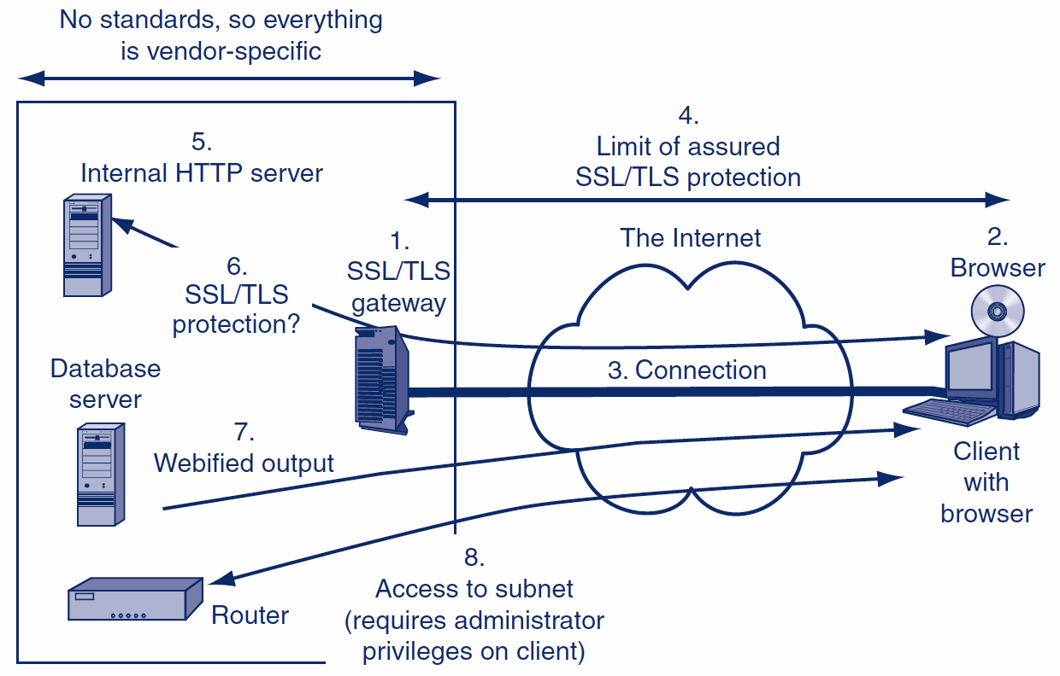
3.10: SSL/TLS and Remote Access VPN Using a Gateway

Slide 78
3.10: IP Security (IPsec) versus SSL/TLS
 | SSL/TLS | IPsec
Cryptographic security standard | Yes | Yes
Cryptographic security protections | Good | Gold Standard
Supports central management | No | Yes
Complexity and expense | Lower | Higher
Layer of operation | Transport | Internet
Transparently protects all higher-layer traffic | No | Yes
Works with IPv4 and IPv6 | NA | Yes
Modes of operation | NA | Transport, Tunnel

Slide 79
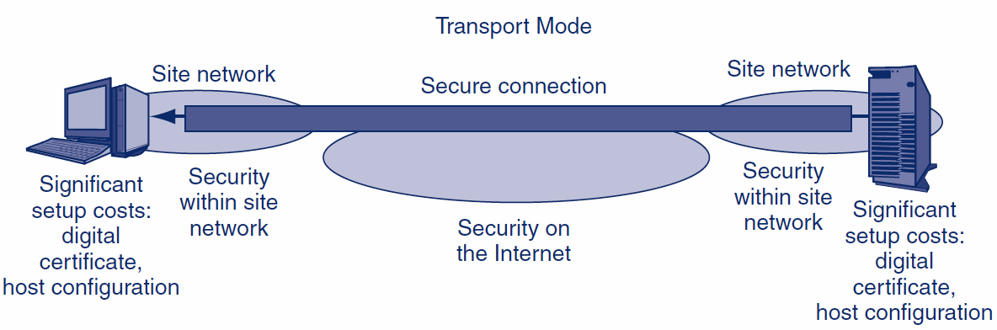
3.10: IPsec Operation: Tunnel and Transport Modes
1.
End-to-End
Security
(Good)
2.
Security in Site Network
(Good)
3.
Setup Cost
On Each Host
(Costly)

Slide 80
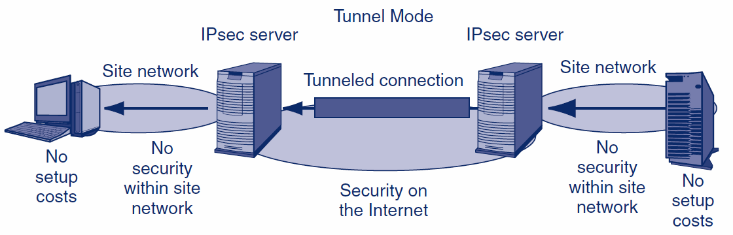
3.10: IPsec Operation: Tunnel and Transport Modes
2.
No Security in Site Network
(Bad)
3.
No Setup Cost
On Each Host
(Good)

Slide 81
3.10: Comparing IPsec Transport and Tunnel Modes
Characteristic | Transport Mode | Tunnel Mode
Uses an IPsec VPN Gateway? | No | Yes
Cryptographic Protection | All the way from the source host to the destination host, including the Internet and the two site networks. | Only over the Internet between the IPsec gateways. Not within the two site networks.
Setup Costs | High. Setup requires the creation of a digital certificate for each client and significant configuration work. | Low. Only the IPsec gateways must implement IPsec, so only they need digital certificates and need to be configured.

Slide 82
3.10: Comparing IPsec Transport and Tunnel Modes
Characteristic | Transport Mode | Tunnel Mode
Firewall Friendliness | Bad. A firewall at the border to a site cannot filter packets because the content is encrypted. | Good. Each packet is decrypted by the IPsec gateway. A border firewall after the IPsec gateway can filter the decrypted packet.
The “Bottom Line” | End-to-end security at high cost. | Low cost. Protects the packet over the most dangerous part of its journey.

Slide 83
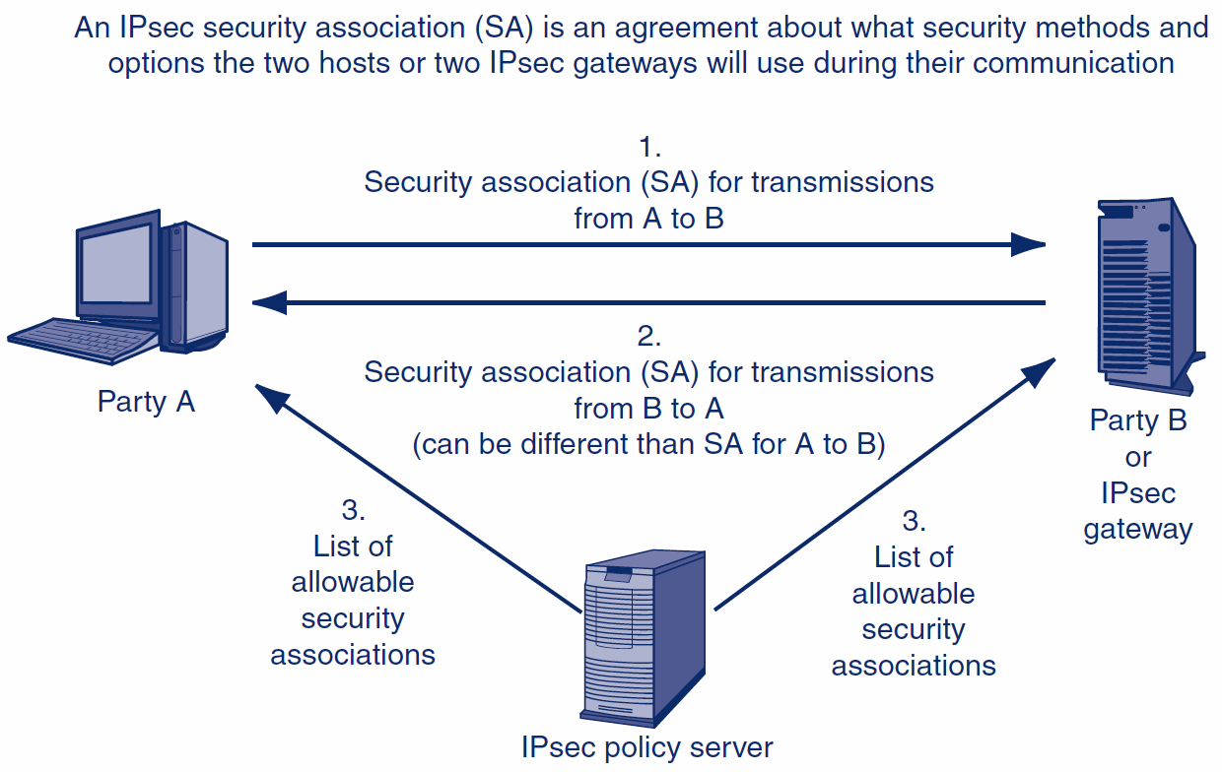
3.10: IPsec Security Associations

Slide 84
The End

Slide 85
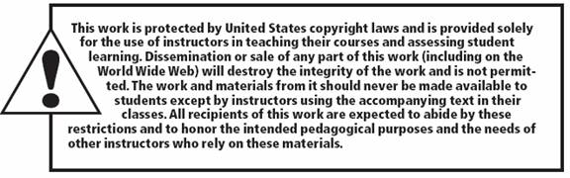
All rights reserved. No part of this publication may be reproduced, stored in a retrieval system, or transmitted, in any form or by any means, electronic, mechanical, photocopying, recording, or otherwise, without the prior written permission of the publisher. Printed in the United States of America.
Copyright © 2015 Pearson Education, Inc.

